Slide 1
冒險
故事

Slide 2
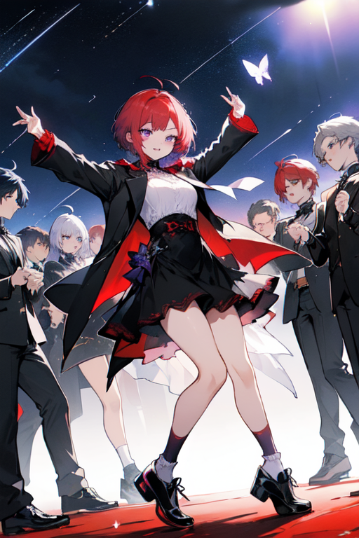
目 標
1

Slide 3
目 標
1

Slide 4
目 標
1
Notes:
ahoge, (wine-red_hair), short_hair, eyebrow_butterfly, (purple_eyes), dressed in vampire coat, ((short_white_socks)), ((black_footwear)), girl, joyful_expression, dancing, celebration, night, starry_sky, a bunch of game players, quality_up, 1boy, high_quality

Slide 5
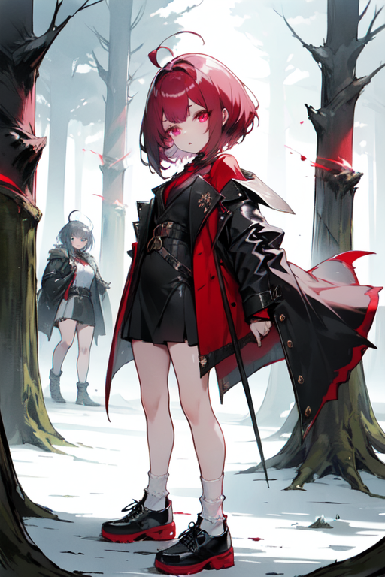
阻 礙
2
Notes:
ahoge, (burgundy_hair), short_hair, dotted_eyebrows, (plum_eyes), wearing_vampire_coat, ( (short_white_socks) ), (black_leather_shoes), girl, monster, glowing_eyes, eerie, forest, game_level, group_of_game_players, quality_boost,

Slide 6
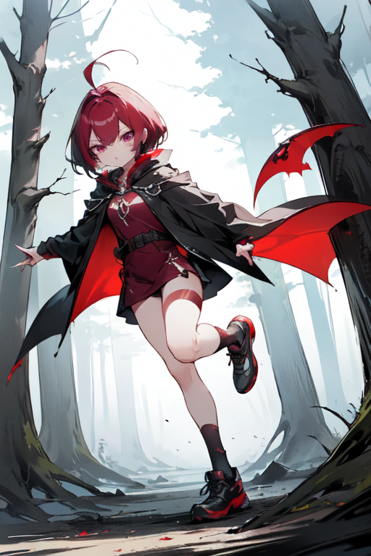
努 力
3

Slide 7
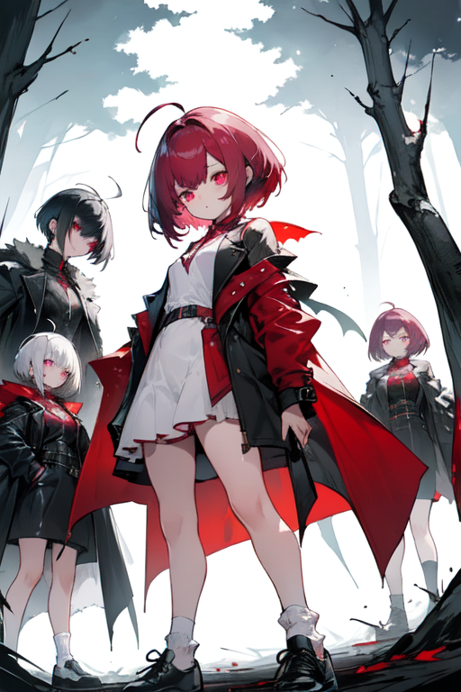
努 力
3
Notes:
ahoge, (bordeaux_hair), short_hair, eyebrows, ()), ((plum_eyes)), wearing a vampire cloak, ((short_white_socks)), ((black_footwear)), girl, monster, training, training, numerical_panel, spooky, forest, game_level, multiple_girls, hd!,

Slide 8
努 力
3
Notes:
ahoge, (burgundy_hair), short_hair, dotted_eyebrows, (plum_eyes), wearing_vampire_coat, ( (short_white_socks) ), (black_leather_shoes), girl, monster, glowing_eyes, eerie, forest, game_level, group_of_game_players, quality_boost,

Slide 9
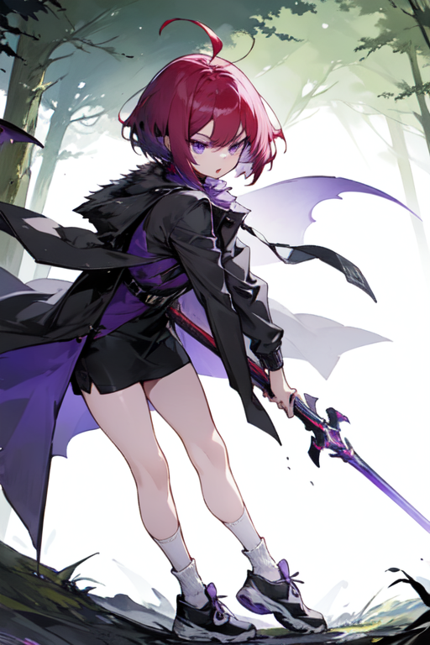
結 果
4
Notes:
ahoge, (burgundy_hair), short_hair, cute_brows, ( (purple_eyes) ), wearing_a_vampire_coat, ( (short_white_socks) ), (black_footwear), girl, wielding_a_weapon, monster, expression_of_surprise, eerie, forest, gameplay_level, multiple_gamers, increased_quality,

Slide 10
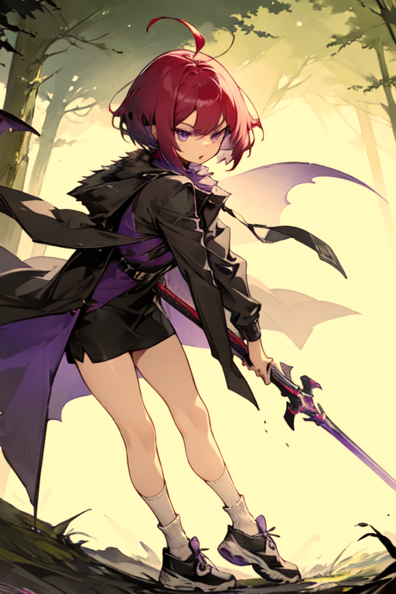
結 果
4

Slide 11
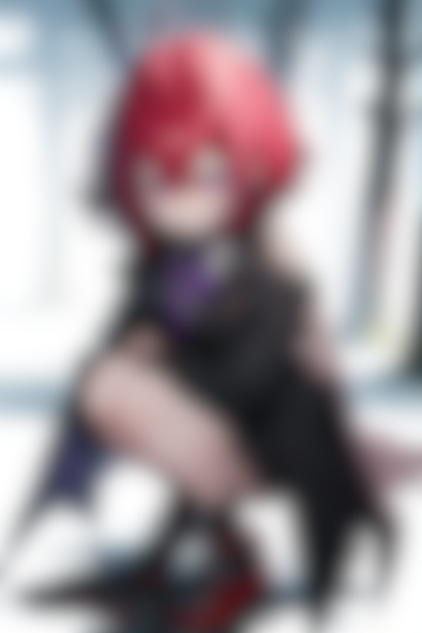
意 外
5

Slide 12
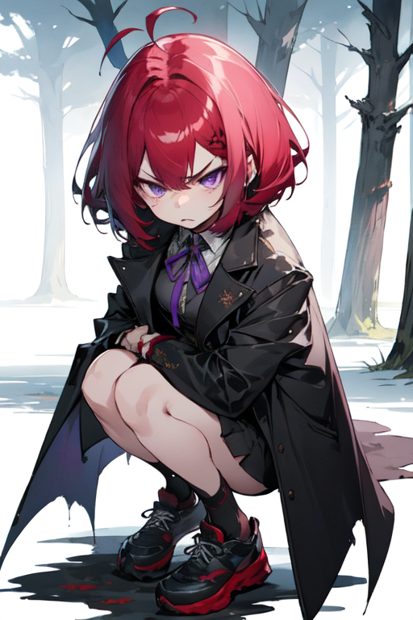
意 外
5
Notes:
ahoge, (burgundy_hair), short_hair, eyebrow_bimbos, ( (purple_eyes]), wearing_ribbon_vampire_coat, ( (short_white_socks)), (black_footwear), girl, monster, angry_expression, bullied, spooky, forest, level_in_game, multiple_gaming_players, improve_quality,

Slide 13
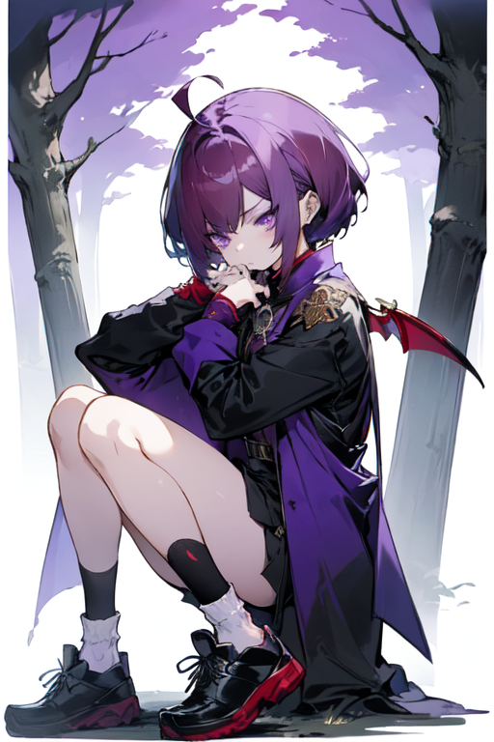
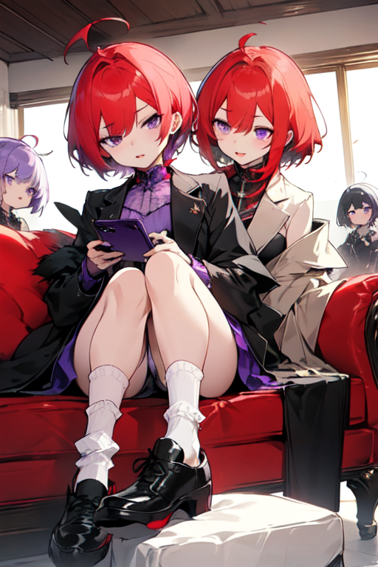
轉 折
6
Notes:
ahoge, (burgundy_hair), short_hair, eyebrow_jewels, ( (purple_eyes) ), wearing a vampire coat, ( (short_white_socks) ), (black_footwear), girl, monster, dejected_expression, mage, knight, samurai, ranger, spooky, forest, level, several players, resolution boost,

Slide 14
轉 折
6
Notes:
ahoge, (crimson_hair), short_hair, eyebrow_shadow, (purple_eyes), wearing_vampire_coat, ( (short_white_socks) ), (black_footwear), sitting_on_couch, girl, holding_phone, phone_image, surprised_expression, happy_expression, multiple_girls, graphics_boost

Slide 15
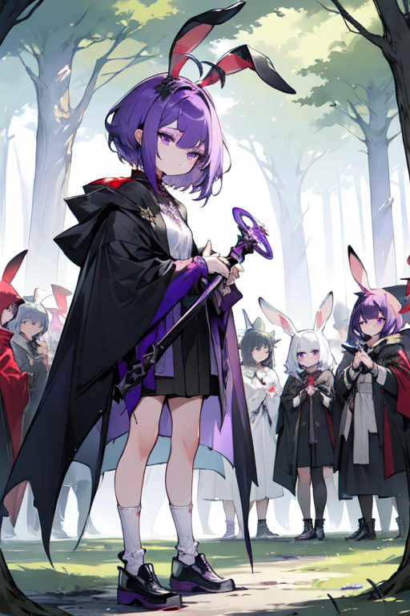
結 局
7
Notes:
ahoge, (burgundy_hair), short_hair, two_bunny_ears, ( (purple_eyes) ), wearing a vampire cloak, ( (short_white_socks) ), (black_footwear), girl, holding_weapon, monster, surprised_expression, spooky, forest, game_level, (crowd), group_of_game_players, quality_up,

